Slide 1
Lab1.2
C Language
(An Application in a Circuit)
Lab1.2
C Language
(An Application in a Circuit)

Slide 2
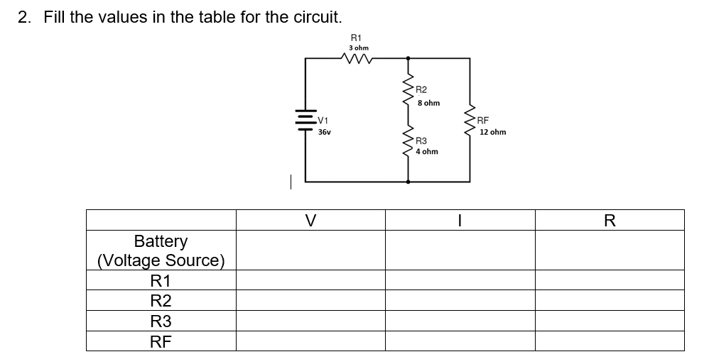
Lab1.2 Assignment
For the circuit diagram below, write a c program that uses given (and one user-supplied) V, I, R values and calculate & answer the values in the table. And, show validation of the results using KCL, KVL.
  Analyze the circuit for Rs in series or parallel
  Prompt users for the given values, meaning R1=3, etc.
  Must code math to calculate circuit V, I, R values. Must include comments.
  Display outputs in a table format.
The values need to be floating point numbers with 2 decimal places (2 number of digits after the decimal point) precision.
Submit screenshots of source code and run results to Bb.

